Slide 1
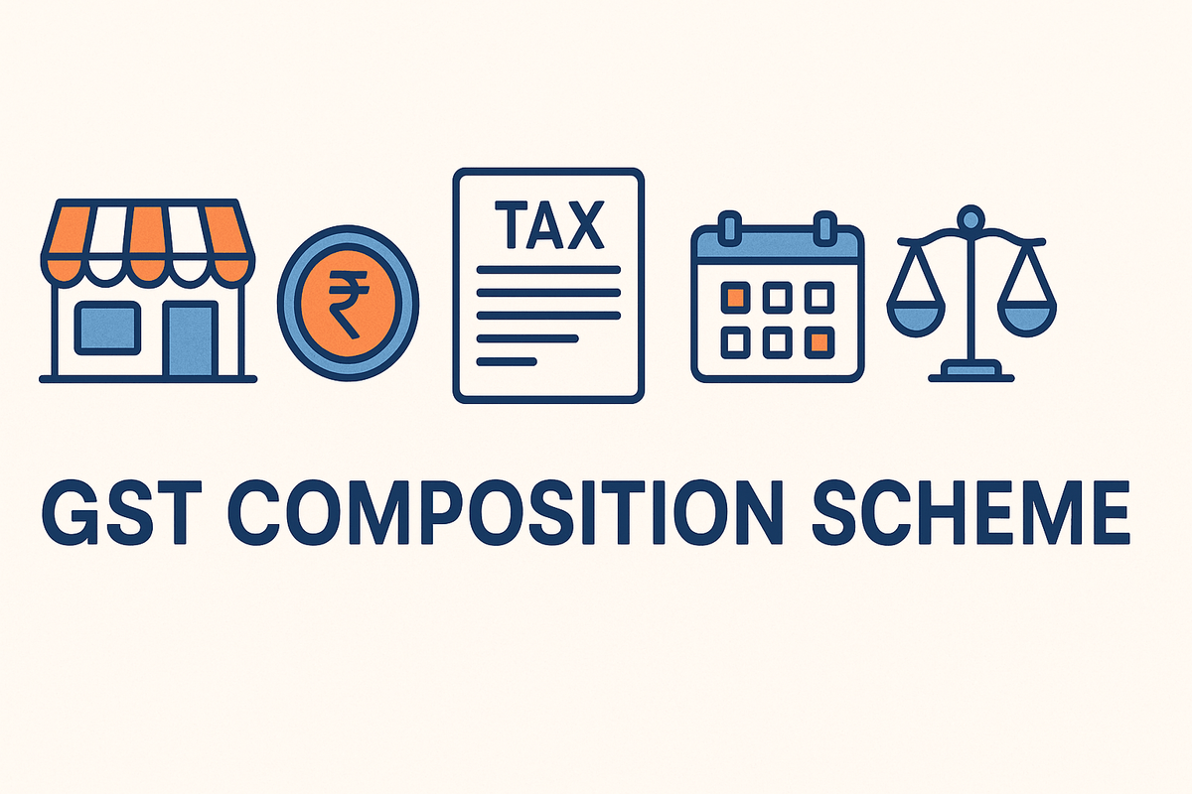
RESEARCH PROJECT REPORT IN FULFILMENT OF SUMMER INTERNSHIP PROJECT
TOPIC:
COMPOSITION SCHEME
SUBMITTED BY: SUBMITTED TO:
Saniya Usmani Shashwat Singhal

Slide 2
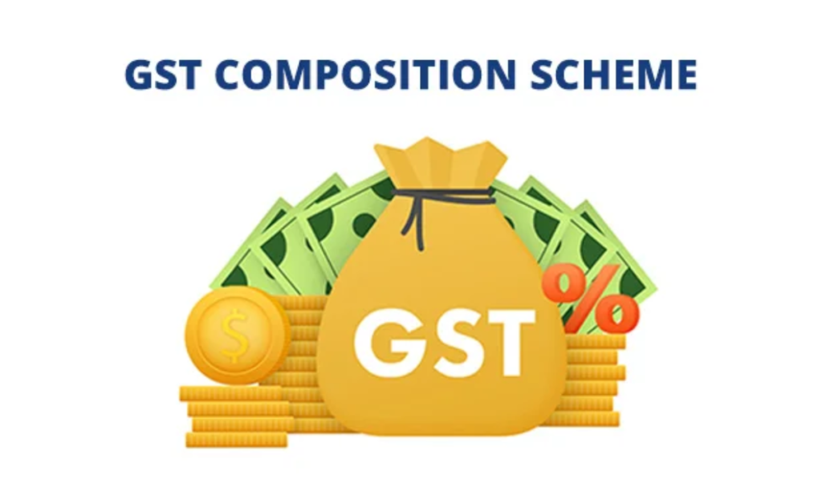
Meaning of Composition Scheme
The Composition Scheme is a simplified tax-paying mechanism available under the Goods and Services Tax (GST) regime for small taxpayers. Instead of paying GST at normal rates and maintaining detailed records, eligible taxpayers can pay tax at a fixed percentage of their turnover.

Slide 3

Legal Framework
The Composition Scheme is governed by:
Section 10 of the Central Goods and Services Tax
(CGST) Act, 2017
CGST Rules, 2017
Notifications issued by the GST Council and Central Government from time to time

Slide 4
Features of the Composition Scheme
Simplified Tax Payment
Reduced Compliance
No Input Tax Credit
Limited Documentation
Lower Tax Rates

Slide 5

Eligibility Criteria
Turnover Limit
A taxpayer may opt for the Composition Scheme if the aggregate turnover in the preceding financial year does not exceed the prescribed limit.
Currently:
Manufacturers and traders: Up to ₹1.5 crore aggregate turnover.
Special category states: Generally up to ₹75 lakh (subject to government notifications).

Slide 6

Eligible Persons
The following can opt for the scheme:
Manufacturers
Traders
Restaurants not serving alcohol
Certain service providers under special composition provisions

Slide 7
Conditions for Eligibility
The taxpayer must:
Not engage in interstate outward supplies.
Not supply goods through e-commerce operators required to collect TCS.
Not manufacture notified goods.
Display “Composition Taxable Person” on signboards and invoices.
Issue a Bill of Supply instead of a Tax Invoice.

Slide 8

Persons Not Eligible
Interstate Suppliers
E-commerce Sellers
Manufacturers of Certain Goods
Casual Taxable Persons

Slide 9
Tax Rates under Composition Scheme
The GST Council has prescribed different rates for different categories.
Category | Composition Tax Rate
Manufacturers and Traders | 1% of turnover
Restaurants (not serving alcohol) | 5% of turnover
Service Providers (Composition-like Scheme) | 6% of turnover

Slide 10
Registration and Procedure
1. Opting for Composition Scheme
A taxpayer may choose the scheme:
At the time of GST registration, or
After registration by filing the prescribed application.
2. Effective Date
The option becomes effective according to GST rules and prescribed procedures.
3. Withdrawal from Scheme
A taxpayer must switch to the regular scheme when:
Turnover exceeds the prescribed limit.
Eligibility conditions are violated.
The taxpayer voluntarily opts out.

Slide 11
Advantages of the Composition Scheme
Reduced Compliance Burden
Lower Cost of Compliance
Simplicity
Improved Cash Flow
Encouragement to Small Enterprises

Slide 12
Disadvantages of the Composition Scheme
No Input Tax Credit
Cannot Collect GST Separately
Restricted Business Expansion
Reduced Competitiveness
Limited Scope

Slide 13
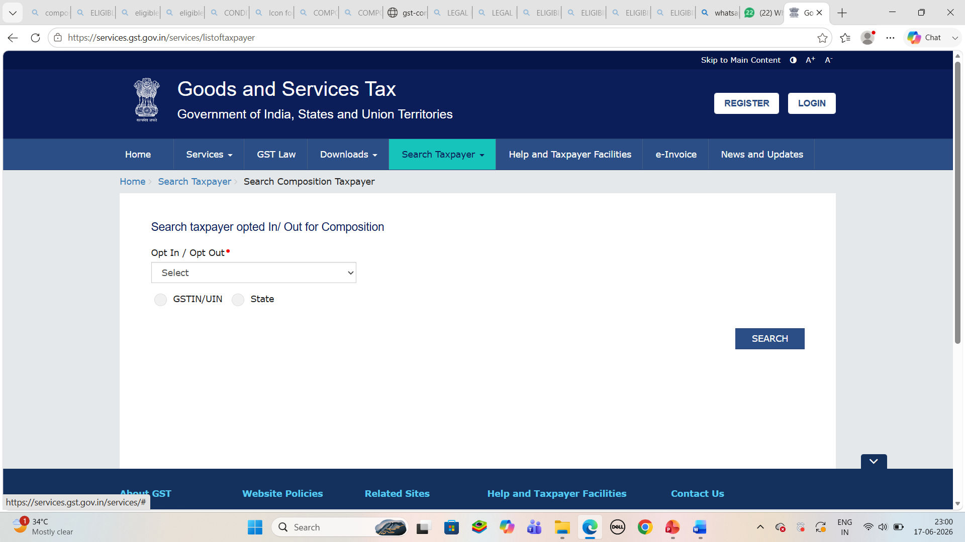
COMPOSITION SCHEME

Slide 14
Conclusion
The Composition Scheme is an important feature of India's GST framework that aims to support small taxpayers by simplifying tax compliance and reducing administrative burdens. It offers lower tax rates, fewer filing requirements, and easier record maintenance. However, businesses opting for the scheme must carefully evaluate its limitations, particularly the inability to claim Input Tax Credit and restrictions on interstate supplies. For many small traders, manufacturers, restaurants, and service providers, the Composition Scheme serves as an effective and economical tax compliance option.

Slide 15


